Slide 1
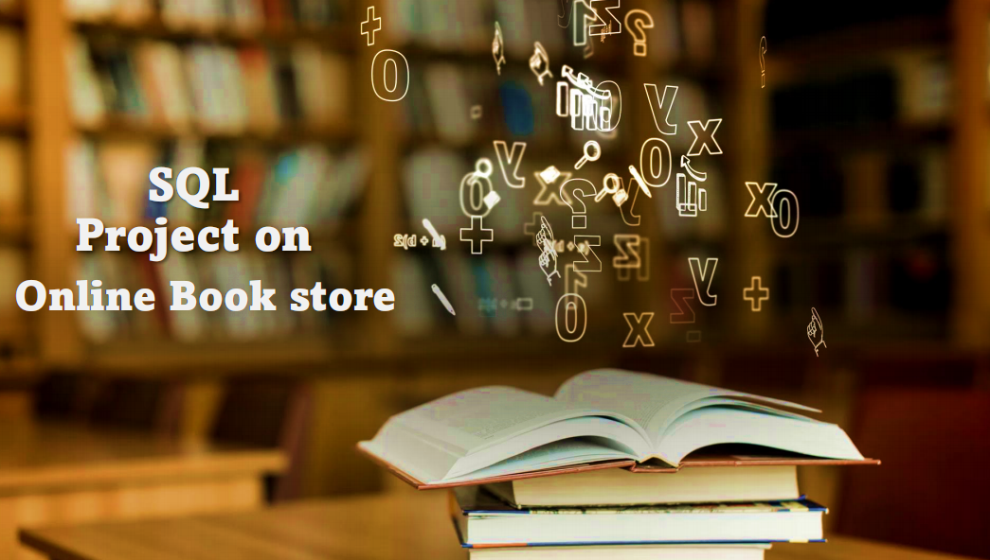
Presented By: Siddhi Shinde

Slide 2
🎯Problem Statement
Difficulty in tracking available stock and updating it after each order.
Lack of insights into sales trends, top customers, and most sold books.
No automated way to calculate revenue and analyze customer purchase behavior.
Poor integration of Books, Customers, and Orders data.

Slide 3
🎯 Objective
Build a relational database for the Online Bookstore.
Store and manage information about Books, Customers, and Orders.
Perform basic SQL queries for data retrieval and management.
Execute advanced SQL queries for analytical insights.
Generate valuable business insights to support decision-making.

Slide 4
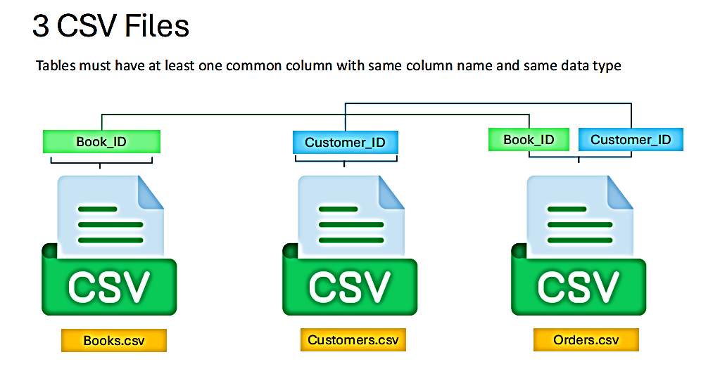

Slide 5
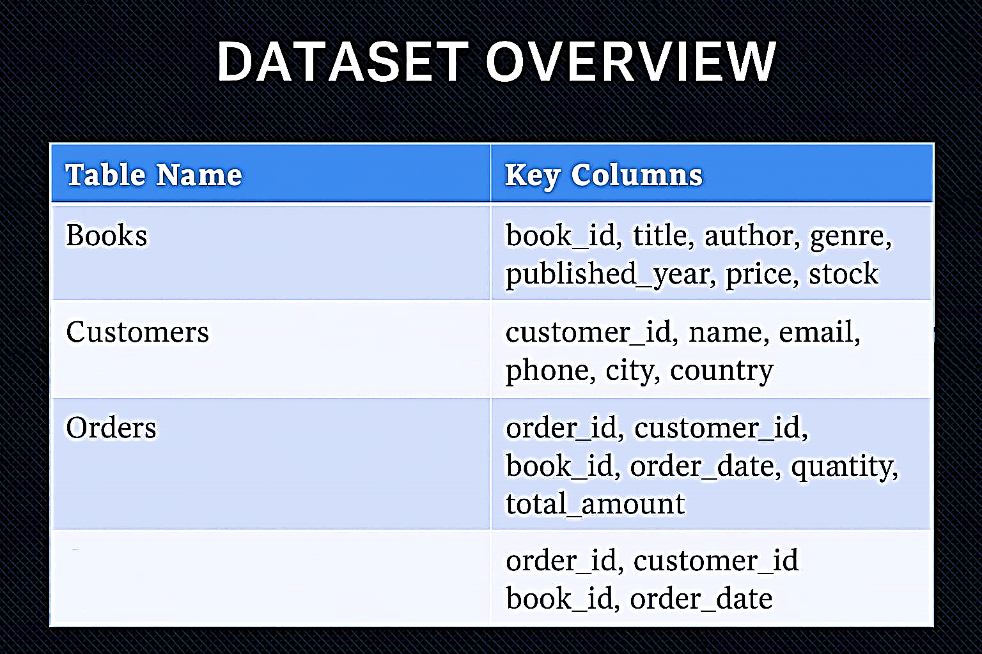
📂 DATASET OVERVIEW

Slide 6
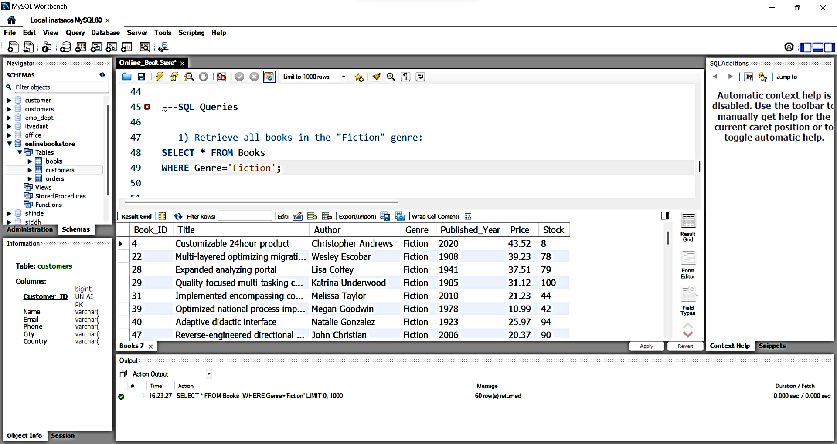
📝 SQL QUERIES
1) Retrieve all books in the "Fiction“ genre:
OUTPUT:

Slide 7
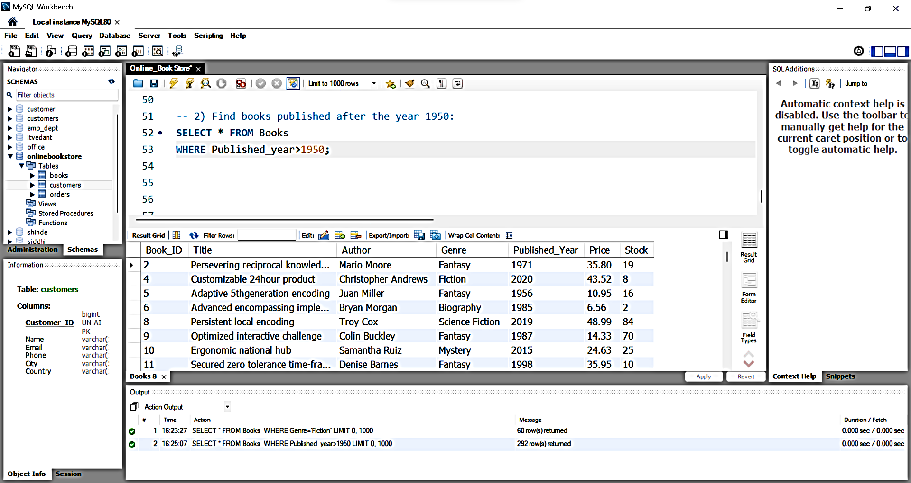
2) Find books published after the year 1950:
OUTPUT:

Slide 8
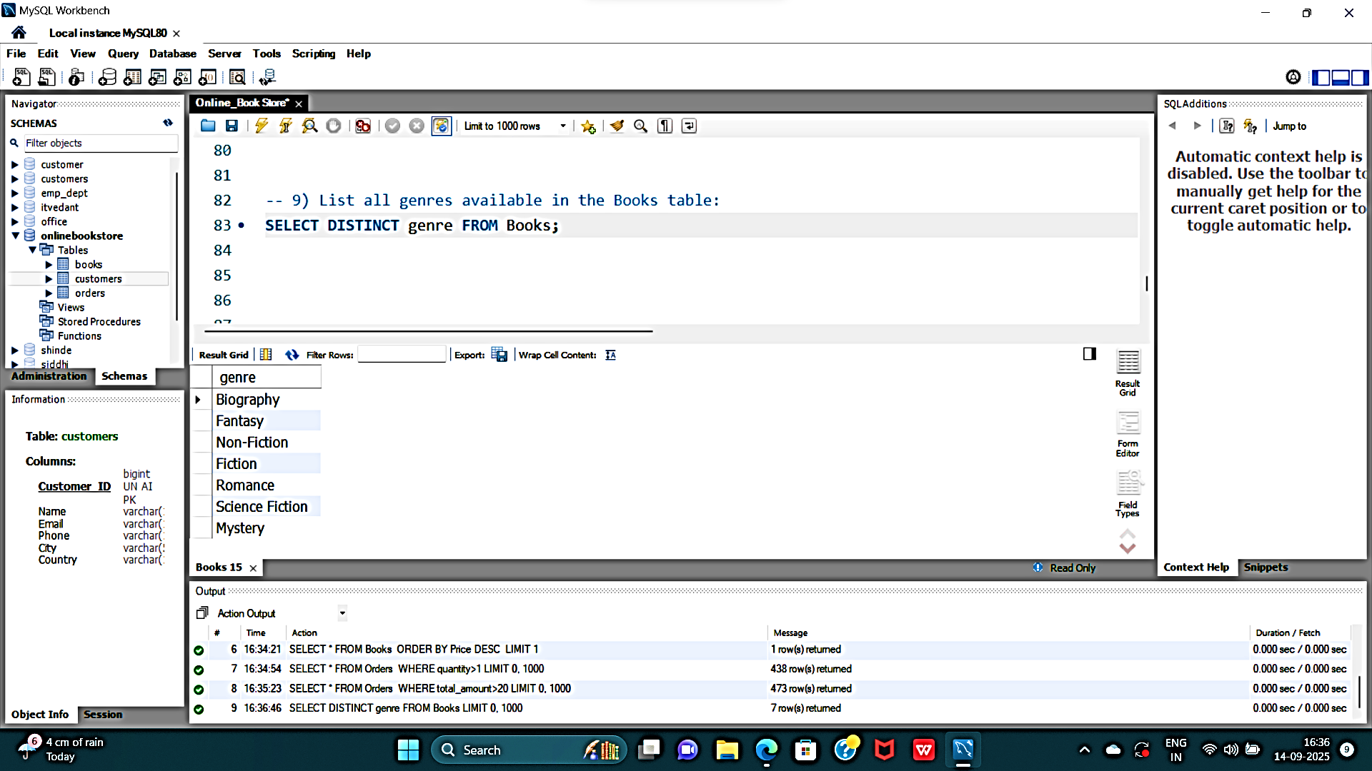
3) List all genres available in the Books table:
OUTPUT:

Slide 9
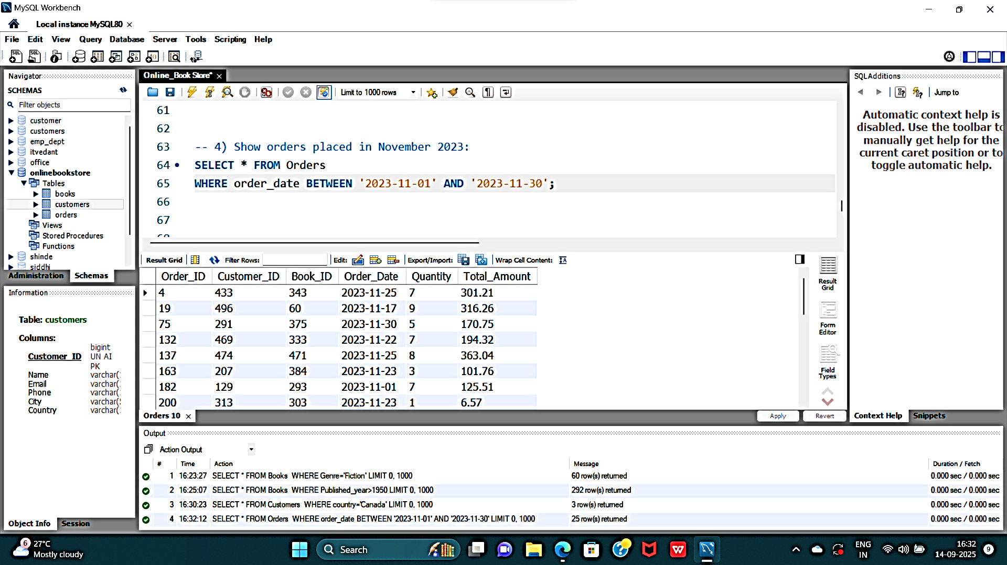
4) Show orders placed in November 2023:
OUTPUT:

Slide 10
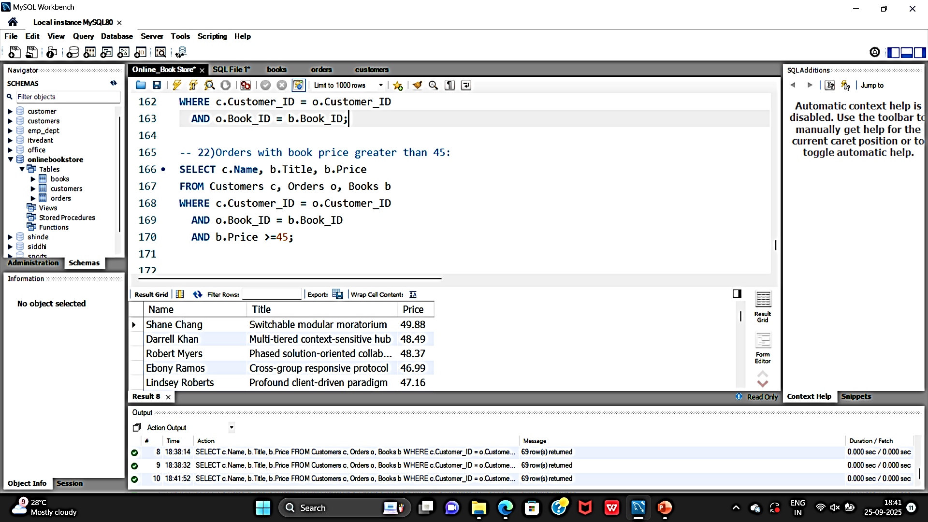
5) Orders with book price greater than 45:
OUTPUT:

Slide 11
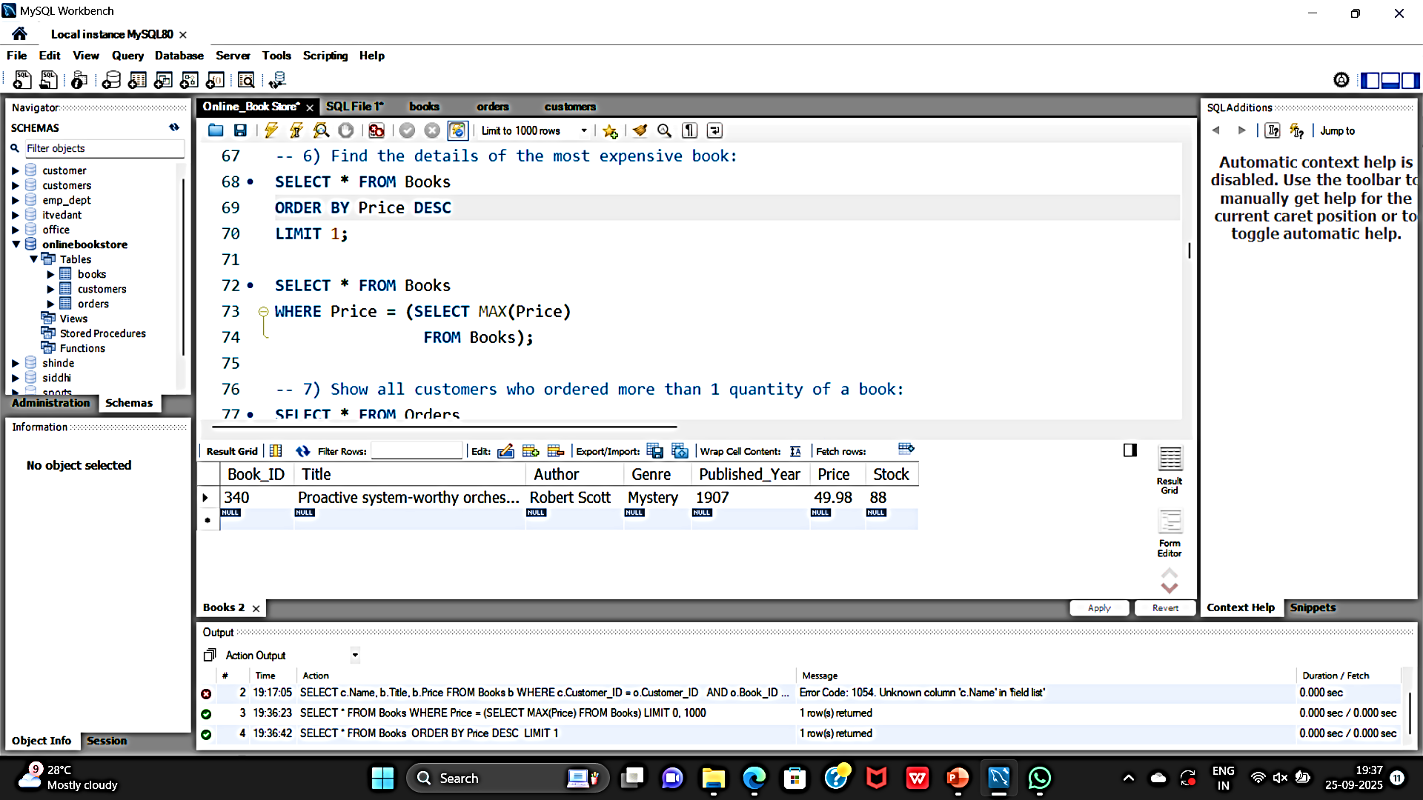
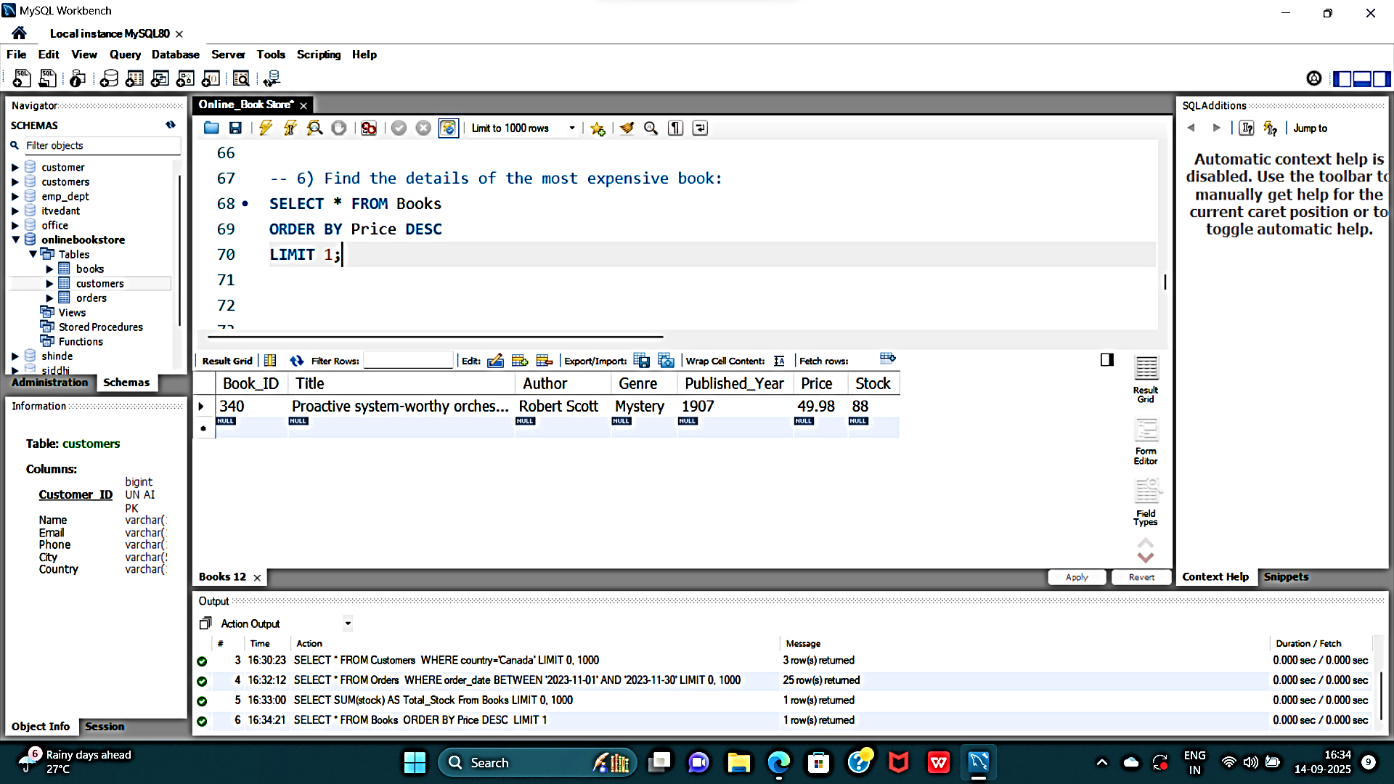
6) Find the details of the most expensive book:
OUTPUT:

Slide 12
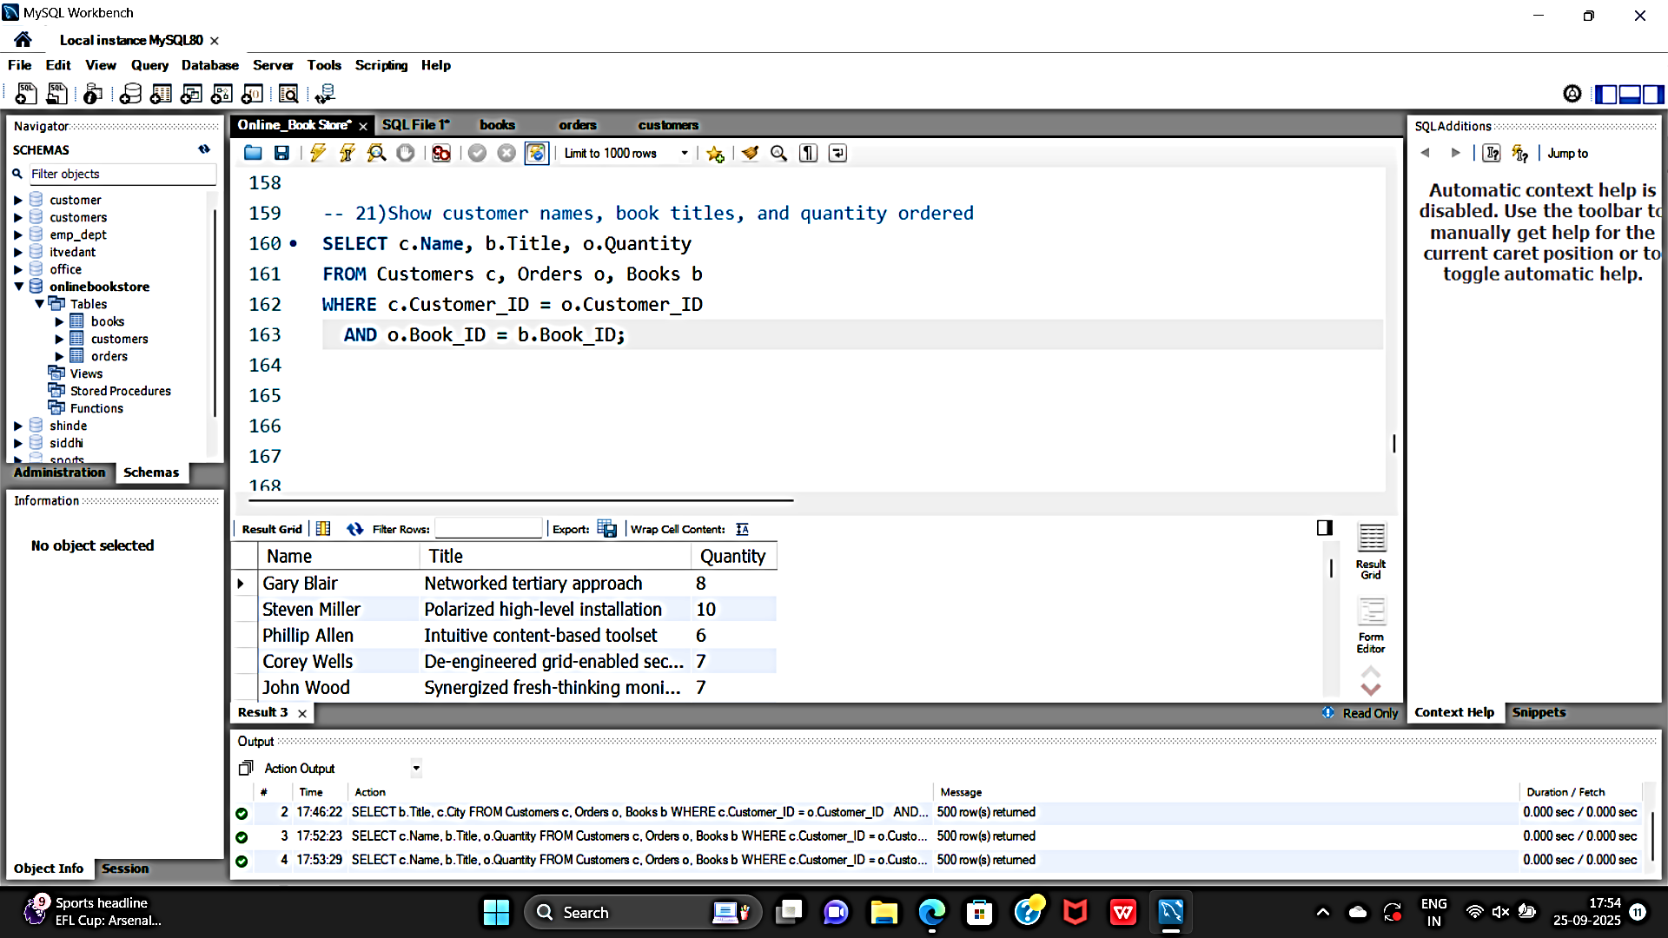
7) Show customer names, book titles, and quantity ordered:
OUTPUT:

Slide 13
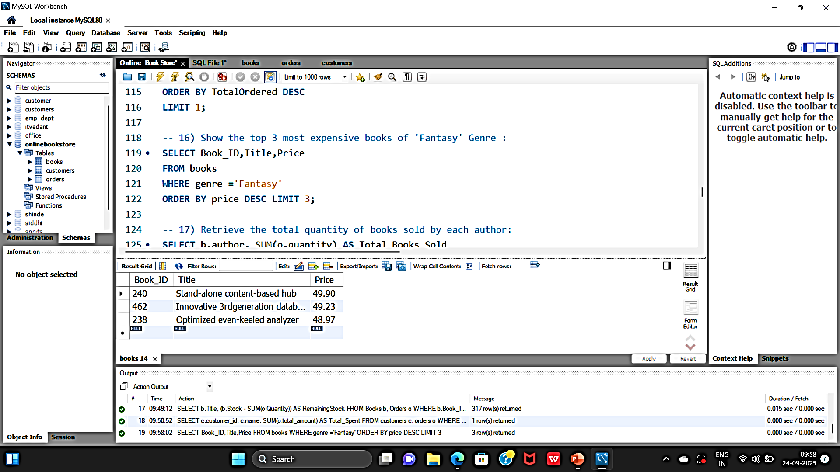
8)Show the top 3 most expensive books of 'Fantasy' Genre :
OUTPUT:

Slide 14
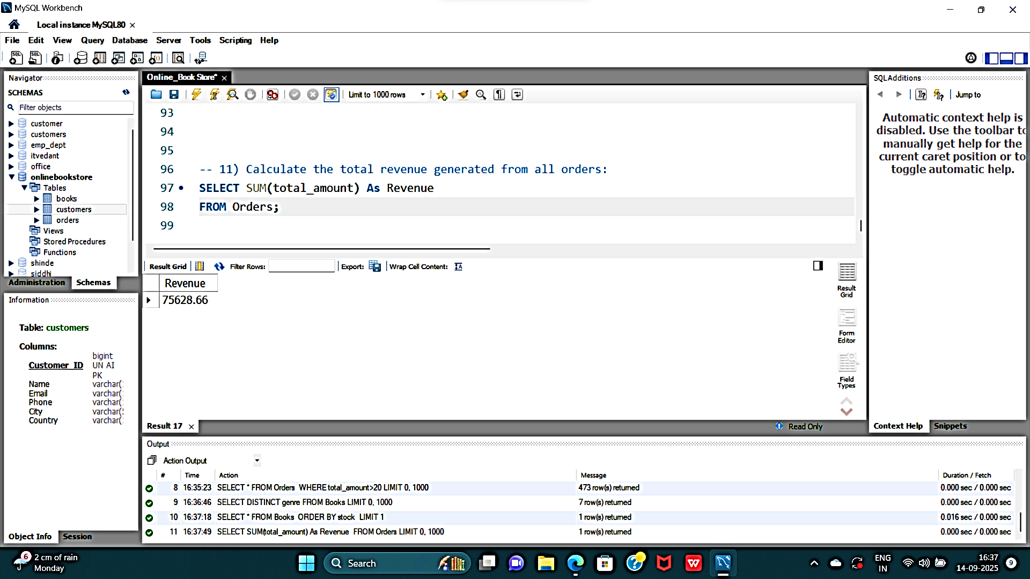
9) Calculate the total revenue generated from all orders:
OUTPUT:

Slide 15
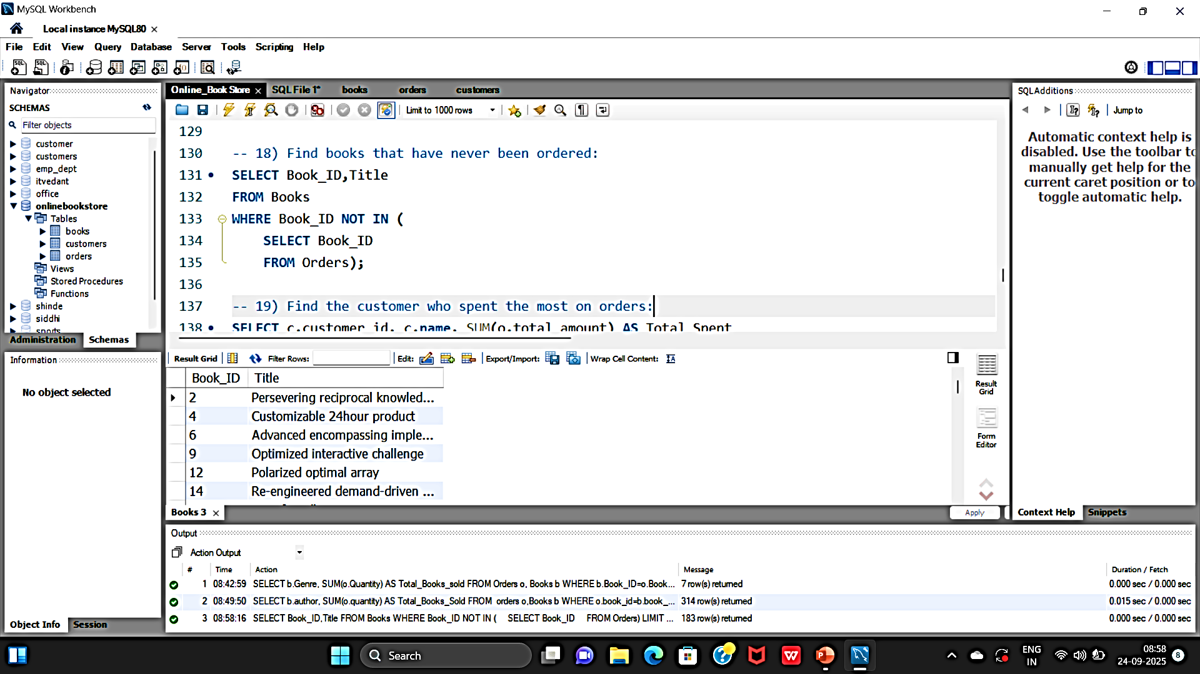
10)Find books that have never been ordered:
OUTPUT:

Slide 16
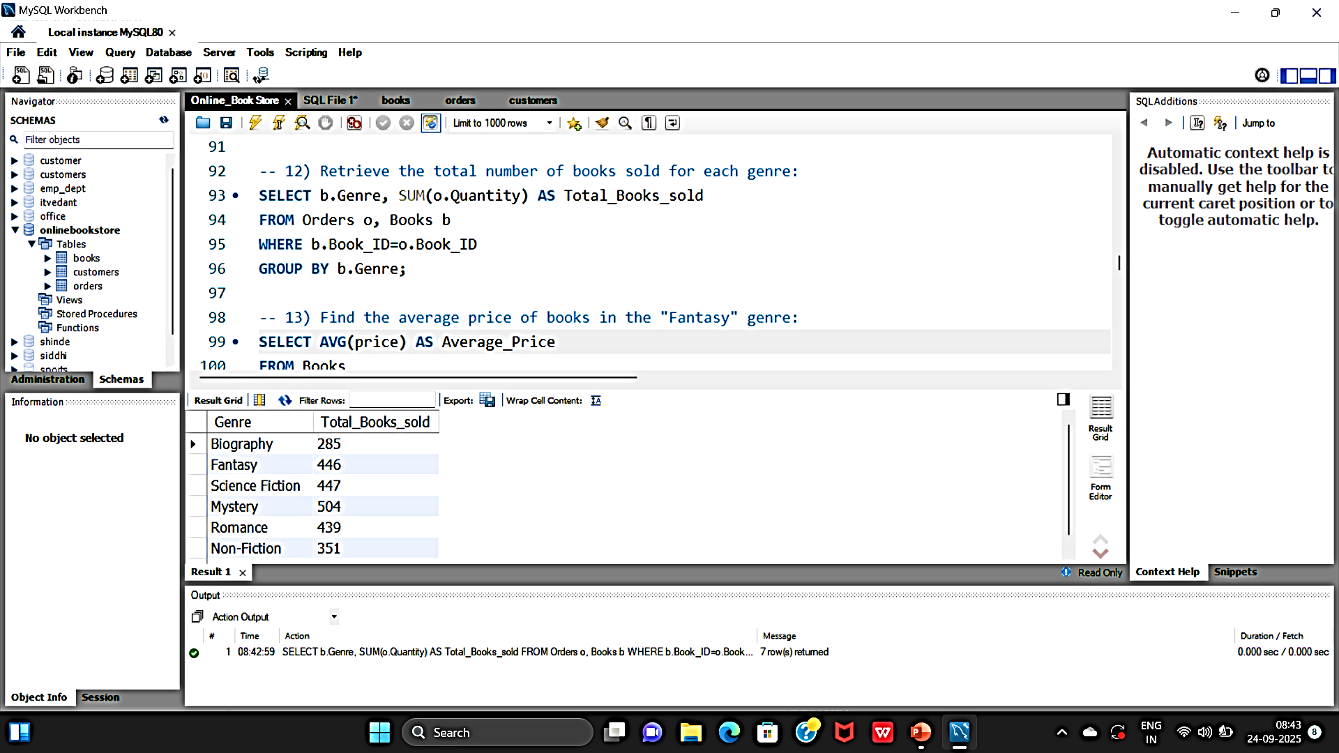
11)Retrieve the total number of books sold for each genre:
OUTPUT:

Slide 17
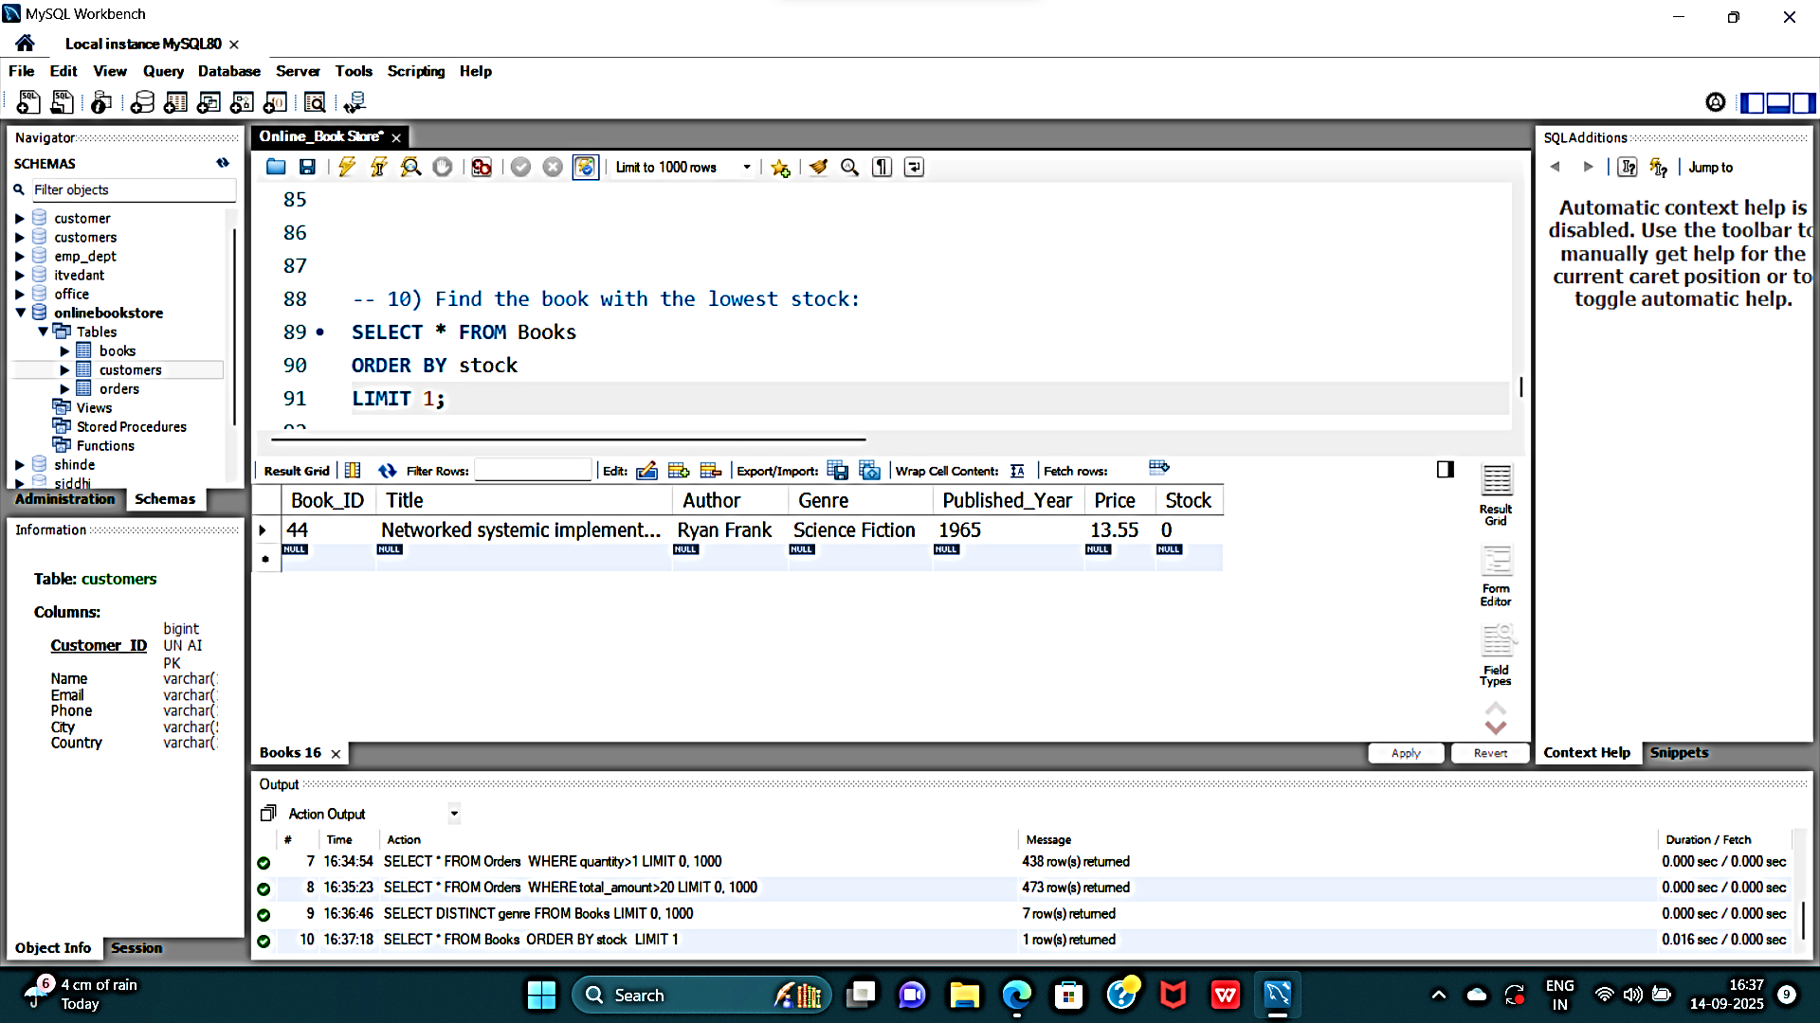
12) Find the book with the lowest stock:
OUTPUT:

Slide 18
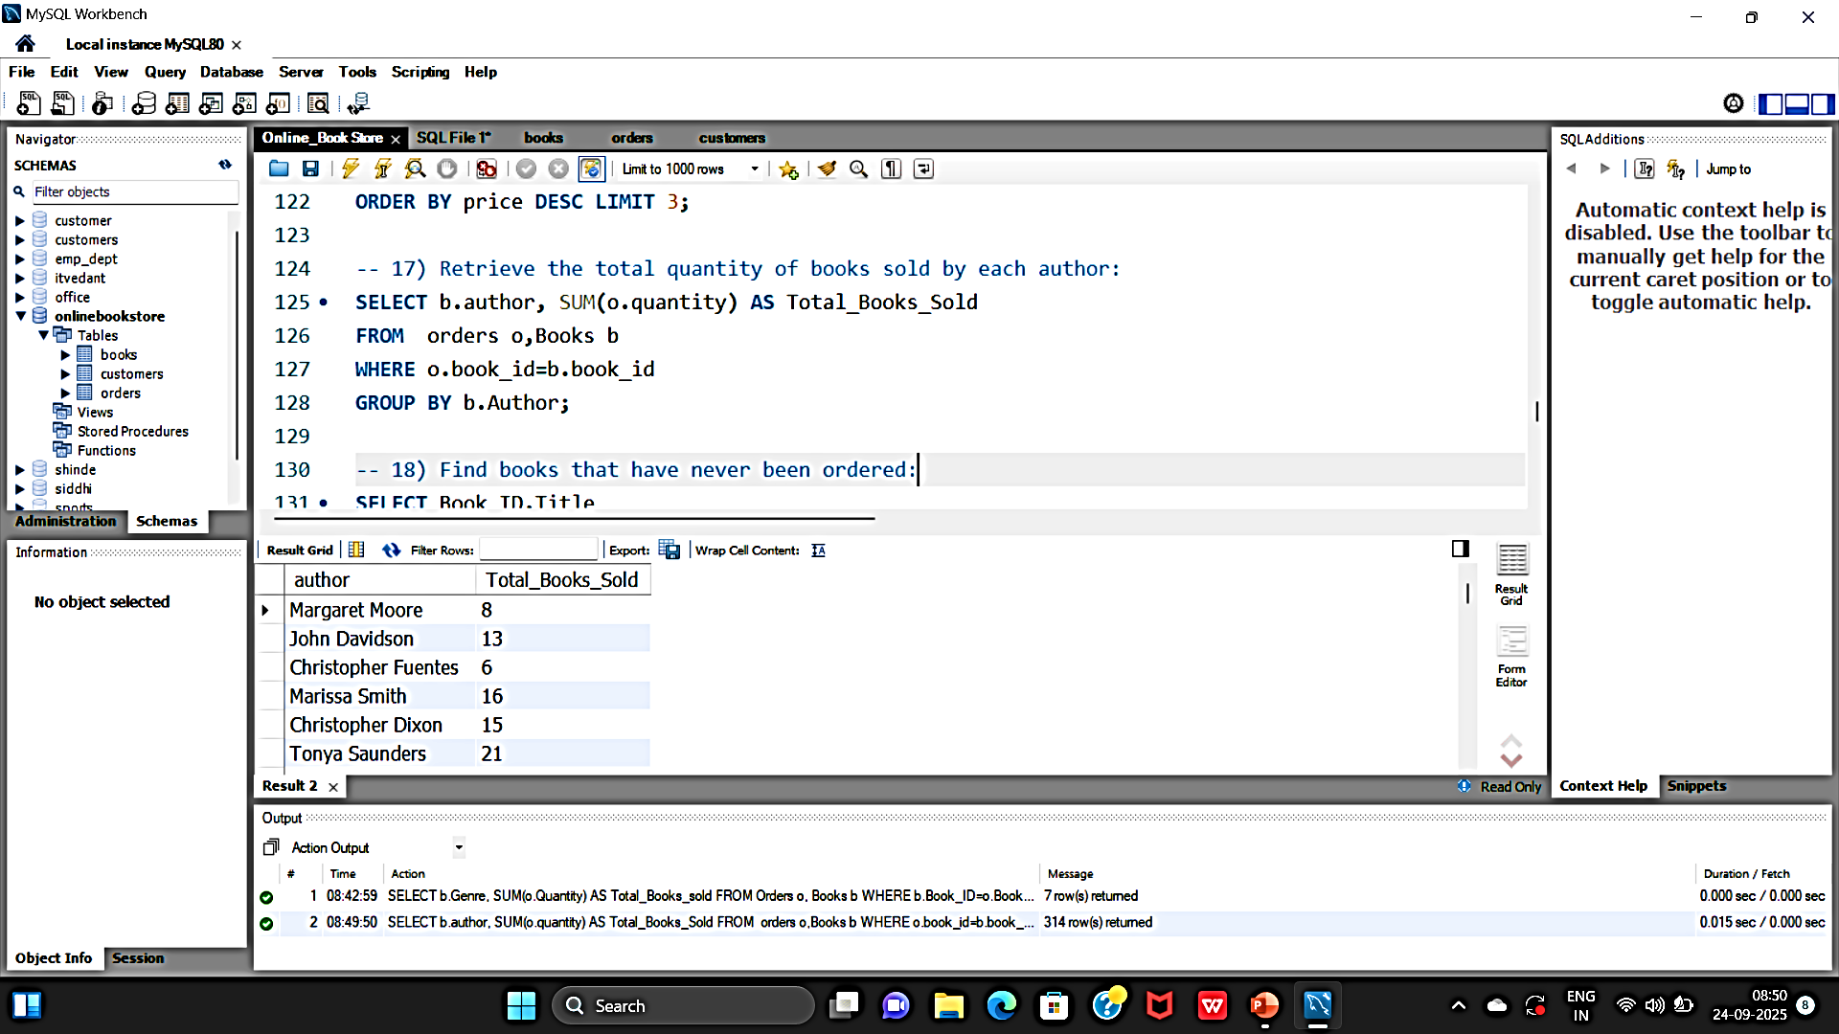
13) Retrieve the total quantity of books sold by each author:
OUTPUT:

Slide 19
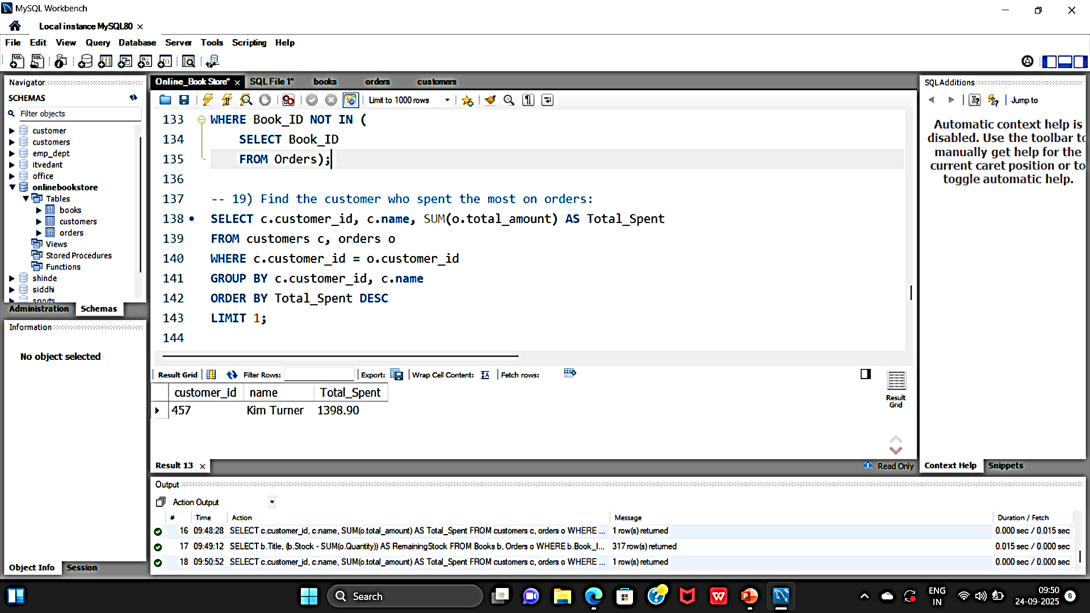
14) Find the customer who spent the most on orders:
OUTPUT:

Slide 20
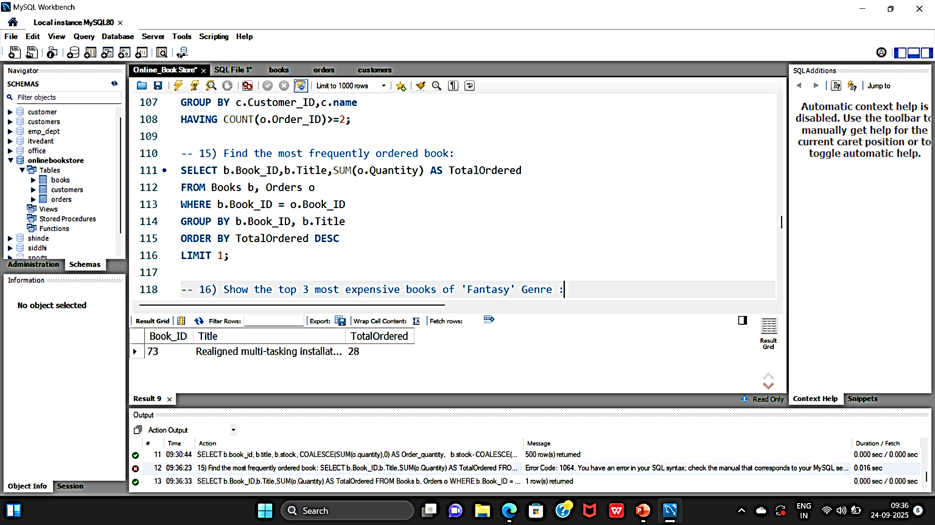
15) Find the most frequently ordered book:
OUTPUT:

Slide 21
💡Insights & Actions
Top genres and authors identified for marketing focus.
Best-selling books highlight customer preferences.
Customer purchase analysis helps in loyalty program design.
Revenue tracking enables financial planning.
Stock management queries improve inventory control.

Slide 22
✅Conclusion
The Online Bookstore database integrates Books, Customers, and Orders in a structured SQL system.
SQL queries allow efficient data management and business analysis.
This project proves the power of SQL in converting raw data into actionable business insights for an e-commerce system.

Slide 23
THANK-YOU!

